Slide 1
Support Vector Machines (SVM) Maximizing the Margin
Wenlu Zhang
CECS@CSULB

Slide 2
SVM
SVM was inspired from Statistical Learning theory
SVM was first introduced in 1992
Boser, Bernhard E., Isabelle M. Guyon, and Vladimir N. Vapnik. "A training algorithm for optimal margin classifiers." In Proceedings of the fifth annual workshop on Computational learning theory, pp. 144-152. ACM, 1992.
SVM becomes popular because of its success in handwritten digit recognition
Bottou, Léon, Corinna Cortes, John S. Denker, Harris Drucker, Isabelle Guyon, Lawrence D. Jackel, Yann LeCun et al. "Comparison of classifier methods: a case study in handwritten digit recognition." In Pattern Recognition, 1994. Vol. 2-Conference B: Computer Vision & Image Processing., Proceedings of the 12th IAPR International. Conference on, vol. 2, pp. 77-82. IEEE, 1994.

Slide 3
Linear Models VS SVM
Linear models are powerful.
Nonlinear transform are increasing expressive power.
Increasing power has a price: overfitting and computation time.
Can we get the expressive power without paying the price? Yes!
SVM-Support Vector Machine

Slide 4
SVM
SVM uses a ‘safety cushion’ when separating the data;
As a result, SVM is more robust to noise;
This helps combat overfitting.

Slide 5


Linear Classifier

Slide 6
Linear Classifier
How would you classify this data?

Slide 7
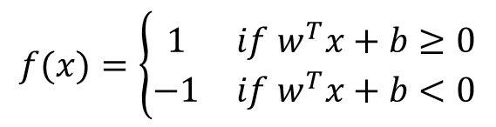
Linear Classifier
$$f(x)=\left\{\begin{matrix}1 & if w^{T}x+b≥0 \\ −1 & if w^{T}x+b<0\end{matrix}\right.$$

Slide 8
Linear Classifier
$$f(x)=\left\{\begin{matrix}1 & if w^{T}x+b≥0 \\ −1 & if w^{T}x+b<0\end{matrix}\right.$$

Slide 9
Linear Classifier
$$f(x)=\left\{\begin{matrix}1 & if w^{T}x+b≥0 \\ −1 & if w^{T}x+b<0\end{matrix}\right.$$
Any of these would be fine …
But, which one is the best?

Slide 10
Linear Classifier
Margin
$$f(x)=\left\{\begin{matrix}1 & if w^{T}x+b≥0 \\ −1 & if w^{T}x+b<0\end{matrix}\right.$$
Margin: the width that the boundary could be increased by before hitting a data point

Slide 11
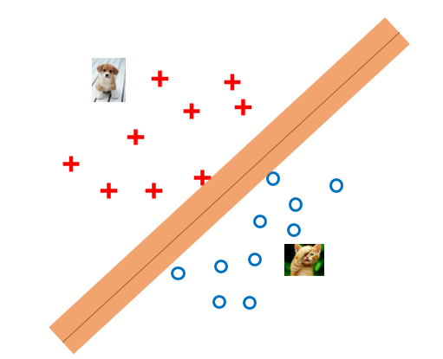
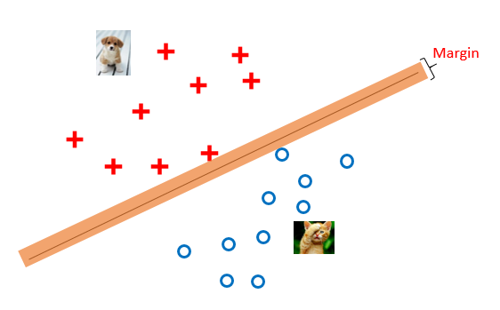
SVM
VS
The maximum margin linear classifier: the linear classifier with the maximum margin
The simplest kind of SVM (called Linear SVM)

Slide 12
SVM
Support Vectors: the data points that the margin pushes up against

Slide 13
SVM
Support Vectors: the data points that the margin pushes up against
Intuitively this feels safest
If we’ve made a small error in the location of the boundary, this gives us least chance of causing a misclassification
The model is immune to removal of any non-support-vector data points
Empirically it works well.

Slide 14


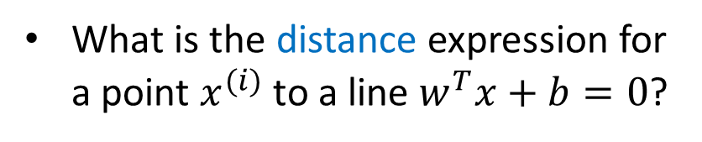
SVM
What is the distance expression for a point $x^{(i)}$ to a line $w^{T}x+b=0$?
$$x^{(i)}$$
$$w^{T}x+b=0$$

Slide 15
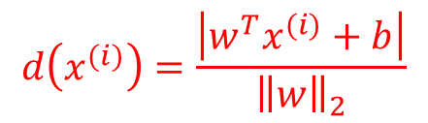
SVM
What is the distance expression for a point $x^{(i)}$ to a line $w^{T}x+b=0$?
$$d\left(x^{(i)}\right)=\frac{\left|w^{T}x^{(i)}+b\right|}{{\left\|w\right\|}_{2}}$$
$$x^{(i)}$$
$$w^{T}x+b=0$$

Slide 16
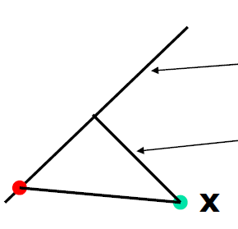



Distance Expression
$$w^{T}x+b=0$$
Distance
$$y$$
$$x^{(i)}$$

Slide 17

Distance Expression
$$w^{T}x+b=0$$
Distance
$$y$$
$$y−x^{(i)}$$
$$x^{(i)}$$

Slide 18

Distance Expression
$$\frac{w}{{\left\|w\right\|}_{2}}$$
$$w^{T}x+b=0$$
Distance
$$y$$
$$y−x^{(i)}$$
$$x^{(i)}$$

Slide 19
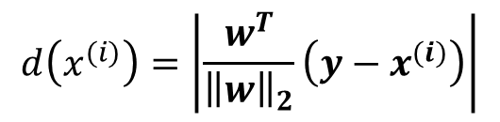
Distance Expression
$$d\left(x^{(i)}\right)=\left|\frac{w^{T}}{{\left\|w\right\|}_{2}}\left(y−x^{(i)}\right)\right|$$
$$\frac{w}{{\left\|w\right\|}_{2}}$$
$$w^{T}x+b=0$$
Distance
$$y$$
$$y−x^{(i)}$$
$$x^{(i)}$$

Slide 20
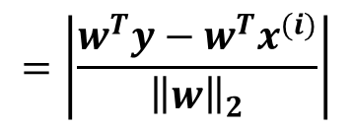
Distance Expression
$$d\left(x^{(i)}\right)=\left|\frac{w^{T}}{{\left\|w\right\|}_{2}}\left(y−x^{(i)}\right)\right|$$
$$\frac{w}{{\left\|w\right\|}_{2}}$$
$$w^{T}x+b=0$$
$$=\left|\frac{w^{T}y−w^{T}x^{(i)}}{{\left\|w\right\|}_{2}}\right|$$
Distance
$$y$$
$$y−x^{(i)}$$
$$x^{(i)}$$

Slide 21
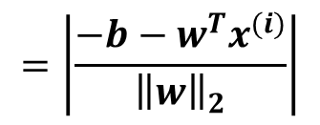
Distance Expression
$$d\left(x^{(i)}\right)=\left|\frac{w^{T}}{{\left\|w\right\|}_{2}}\left(y−x^{(i)}\right)\right|$$
$$\frac{w}{{\left\|w\right\|}_{2}}$$
$$w^{T}x+b=0$$
$$=\left|\frac{w^{T}y−w^{T}x^{(i)}}{{\left\|w\right\|}_{2}}\right|$$
Distance
$$y$$
$$=\left|\frac{−b−w^{T}x^{(i)}}{{\left\|w\right\|}_{2}}\right|$$
$$y−x^{(i)}$$
$$x^{(i)}$$

Slide 22
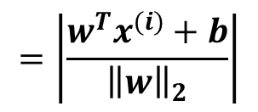
Distance Expression
$$d\left(x^{(i)}\right)=\left|\frac{w^{T}}{{\left\|w\right\|}_{2}}\left(y−x^{(i)}\right)\right|$$
$$\frac{w}{{\left\|w\right\|}_{2}}$$
$$w^{T}x+b=0$$
$$=\left|\frac{w^{T}y−w^{T}x^{(i)}}{{\left\|w\right\|}_{2}}\right|$$
Distance
$$y$$
$$=\left|\frac{−b−w^{T}x^{(i)}}{{\left\|w\right\|}_{2}}\right|$$
$$y−x^{(i)}$$
$$x^{(i)}$$
$$=\left|\frac{w^{T}x^{(i)}+b}{{\left\|w\right\|}_{2}}\right|$$

Slide 23
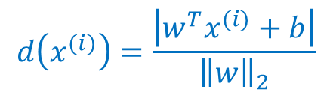
SVM
What is the distance expression for a point $x^{(i)}$ to a line $w^{T}x+b=0$?
$$d\left(x^{(i)}\right)=\frac{\left|w^{T}x^{(i)}+b\right|}{{\left\|w\right\|}_{2}}$$
$$x^{(i)}$$
$$w^{T}x+b=0$$

Slide 24

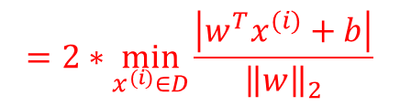
SVM
What is the distance expression for a point $x^{(i)}$ to a line $w^{T}x+b=0$?
$$d\left(x^{(i)}\right)=\frac{\left|w^{T}x^{(i)}+b\right|}{{\left\|w\right\|}_{2}}$$
$$x^{(i)}$$
Margin: the width that the boundary could be increased by before hitting a data point
$$margin ≡2∗\min_{x^{\left(i\right)}∈D}{d\left(x^{\left(i\right)}\right)}$$
$$=2∗\min_{x^{(i)}∈D}{\frac{\left|w^{T}x^{(i)}+b\right|}{{\left\|w\right\|}_{2}}}$$
$$w^{T}x+b=0$$

Slide 25


SVM
Linear SVM
A maximum margin classifier
Preventing data points from falling into the margin
$$x^{(i)}$$
$$w^{T}x+b=0$$

Slide 26
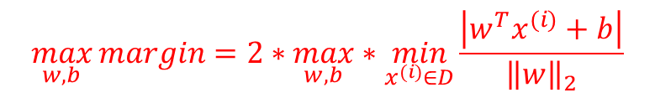
SVM
Linear SVM
A maximum margin classifier
Preventing data points from falling into the margin
$$x^{(i)}$$
$$\max_{w, b}{margin}=2∗\max_{w, b}∗\min_{x^{(i)}∈D}{\frac{\left|w^{T}x^{(i)}+b\right|}{{\left\|w\right\|}_{2}}}$$
$$w^{T}x+b=0$$

Slide 27
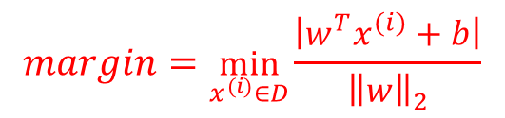
SVM
Linear SVM
A maximum margin classifier
Preventing data points from falling into the margin
$$x^{(i)}$$
$$\max_{w, b}{margin}=2∗\max_{w, b}∗\min_{x^{(i)}∈D}{\frac{\left|w^{T}x^{(i)}+b\right|}{{\left\|w\right\|}_{2}}}$$
$$w^{T}x+b=0$$
$$margin=\min_{x^{(i)}∈D}{\frac{\left|w^{T}x^{(i)}+b\right|}{{\left\|w\right\|}_{2}}}$$

Slide 28
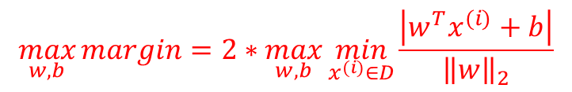
SVM
Linear SVM
A maximum margin classifier
Preventing data points from falling into the margin
$$x^{(i)}$$
$$\max_{w, b}{margin}=2∗\max_{w, b}\min_{x^{(i)}∈D}{\frac{\left|w^{T}x^{(i)}+b\right|}{{\left\|w\right\|}_{2}}}$$
$$w^{T}x+b=0$$
$$margin=\min_{x^{(i)}∈D}{\frac{\left|w^{T}x^{(i)}+b\right|}{{\left\|w\right\|}_{2}}}$$

Slide 29
SVM
Linear SVM
A maximum margin classifier
Preventing data points from falling into the margin
$$x^{(i)}$$
$$\max_{w, b}{margin}=2∗\max_{w, b}\min_{x^{(i)}∈D}{\frac{\left|w^{T}x^{(i)}+b\right|}{{\left\|w\right\|}_{2}}}$$
$$w^{T}x+b=0$$
$$margin=\min_{x^{(i)}∈D}{\frac{\left|w^{T}x^{(i)}+b\right|}{{\left\|w\right\|}_{2}}}$$

Slide 30
SVM
Linear SVM
A maximum margin classifier
Preventing data points from falling into the margin
Hard margin
$$x^{(i)}$$
$$\max_{w, b}{margin}=2∗\max_{w, b}\min_{x^{(i)}∈D}{\frac{\left|w^{T}x^{(i)}+b\right|}{{\left\|w\right\|}_{2}}}$$
$$w^{T}x+b=0$$
$$margin=\min_{x^{(i)}∈D}{\frac{\left|w^{T}x^{(i)}+b\right|}{{\left\|w\right\|}_{2}}}$$

Slide 31



SVM
Linear SVM
A maximum margin classifier
Preventing data points from falling into the margin
$$\max_{w, b}{margin}=2∗\max_{w, b}\min_{x^{(i)}∈D}{\frac{\left|w^{T}x^{(i)}+b\right|}{{\left\|w\right\|}_{2}}}$$
$$w^{T}x+b=−δ$$
$$w^{T}x+b=0$$
$$w^{T}x+b=δ$$

Slide 32


SVM
Linear SVM
A maximum margin classifier
Preventing data points from falling into the margin
$$\max_{w, b}{margin}=2∗\max_{w, b}\min_{x^{(i)}∈D}{\frac{\left|w^{T}x^{(i)}+b\right|}{{\left\|w\right\|}_{2}}}$$
$$w^{T}x+b=−1$$
$$w^{T}x+b=0$$
$$w^{T}x+b=1$$

Slide 33


SVM
Linear SVM
A maximum margin classifier
Preventing data points from falling into the margin
$$w^{T}x+b≤−1$$
$$\max_{w, b}{margin}=2∗\max_{w, b}\min_{x^{(i)}∈D}{\frac{\left|w^{T}x^{(i)}+b\right|}{{\left\|w\right\|}_{2}}}$$
$$w^{T}x+b≥1$$
$$w^{T}x+b=−1$$
$$w^{T}x+b=0$$
$$w^{T}x+b=1$$

Slide 34





SVM
Linear SVM
A maximum margin classifier
Preventing data points from falling into the margin
$$w^{T}x+b≤−1$$
$$\max_{w, b}{margin}=2∗\max_{w, b}\min_{x^{(i)}∈D}{\frac{\left|w^{T}x^{(i)}+b\right|}{{\left\|w\right\|}_{2}}}$$
For a data point $x^{(i)}$,
if its target $t^{(i)}=1$,
$$w^{T}x^{(i)}+b≥1$$
if its target $t^{(i)}=−1$,
$$w^{T}x^{(i)}+b≤−1$$
$$w^{T}x+b≥1$$
$$w^{T}x+b=−1$$
$$w^{T}x+b=0$$
$$w^{T}x+b=1$$

Slide 35

SVM
Linear SVM
A maximum margin classifier
Preventing data points from falling into the margin
$$w^{T}x+b≤−1$$
$$\max_{w, b}{margin}=2∗\max_{w, b}\min_{x^{(i)}∈D}{\frac{\left|w^{T}x^{(i)}+b\right|}{{\left\|w\right\|}_{2}}}$$
For a data point $x^{(i)}$,
if its target $t^{(i)}=1$,
$$w^{T}x^{(i)}+b≥1$$
if its target $t^{(i)}=−1$,
$$w^{T}x^{(i)}+b≤−1$$
$$w^{T}x+b≥1$$
So we want
$$w^{T}x+b=−1$$
$$\left(w^{T}x^{(i)}+b \right)t^{(i)}≥1$$
$$w^{T}x+b=0$$
$$w^{T}x+b=1$$

Slide 36


SVM
Linear SVM
A maximum margin classifier
Preventing data points from falling into the margin
$$\max_{w, b}{margin}=2∗\max_{w, b}\min_{x^{(i)}∈D}{\frac{\left|w^{T}x^{(i)}+b\right|}{{\left\|w\right\|}_{2}}}$$
$$s.t.$$
$$∀i , \left(w^{T}x^{(i)}+b \right)t^{(i)}≥1$$
$$w^{T}x+b=−1$$
$$w^{T}x+b=0$$
$$w^{T}x+b=1$$

Slide 37

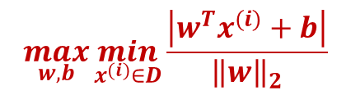
SVM
$$\max_{w, b}{\min_{x^{(i)}∈D}{\frac{\left|w^{T}x^{(i)}+b\right|}{{\left\|w\right\|}_{2}}}}$$
$$\max_{w, b}{\frac{1}{{\left\|w\right\|}_{2}}}$$
Linear SVM
A maximum margin classifier
Preventing data points from falling into the margin
$$\max_{w, b}{margin}=2∗\max_{w, b}\min_{x^{(i)}∈D}{\frac{\left|w^{T}x^{(i)}+b\right|}{{\left\|w\right\|}_{2}}}$$
$$s.t.$$
$$∀i , \left(w^{T}x^{(i)}+b \right)t^{(i)}≥1$$
$$w^{T}x+b=−1$$
$$w^{T}x+b=0$$
$$w^{T}x+b=1$$

Slide 38
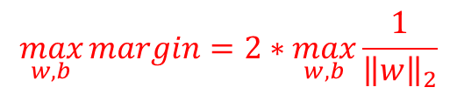
SVM
$$\max_{w, b}{\min_{x^{(i)}∈D}{\frac{\left|w^{T}x^{(i)}+b\right|}{{\left\|w\right\|}_{2}}}}$$
$$\max_{w, b}{\frac{1}{{\left\|w\right\|}_{2}}}$$
Linear SVM
A maximum margin classifier
Preventing data points from falling into the margin
$$\max_{w, b}{margin}=2∗\max_{w, b}\frac{1}{{\left\|w\right\|}_{2}}$$
$$s.t.$$
$$∀i , \left(w^{T}x^{(i)}+b \right)t^{(i)}≥1$$
$$w^{T}x+b=−1$$
$$w^{T}x+b=0$$
$$w^{T}x+b=1$$

Slide 39




SVM
$$\max_{w, b}{\min_{x^{(i)}∈D}{\frac{\left|w^{T}x^{(i)}+b\right|}{{\left\|w\right\|}_{2}}}}$$
$$\max_{w, b}{\frac{1}{{\left\|w\right\|}_{2}}}$$
$$\min_{w, b} \frac{1}{2}{\left\|w\right\|}_{2}^{2}$$
Linear SVM
A maximum margin classifier
Preventing data points from falling into the margin
$$\min_{w, b} \frac{1}{2}{\left\|w\right\|}_{2}^{2}$$
$$s.t.$$
$$∀i , \left(w^{T}x^{(i)}+b \right)t^{(i)}≥1$$
$$w^{T}x+b=−1$$
$$w^{T}x+b=0$$
$$w^{T}x+b=1$$

Slide 40



SVM
Linear SVM
A maximum margin classifier
Preventing data points from falling into the margin
$$\min_{w, b} \frac{1}{2}{\left\|w\right\|}_{2}^{2}$$
$$s.t.$$
$$∀i , \left(w^{T}x^{(i)}+b \right)t^{(i)}≥1$$
A constrained minimization
$$w^{T}x+b=−1$$
$$w^{T}x+b=0$$
$$w^{T}x+b=1$$

Slide 41
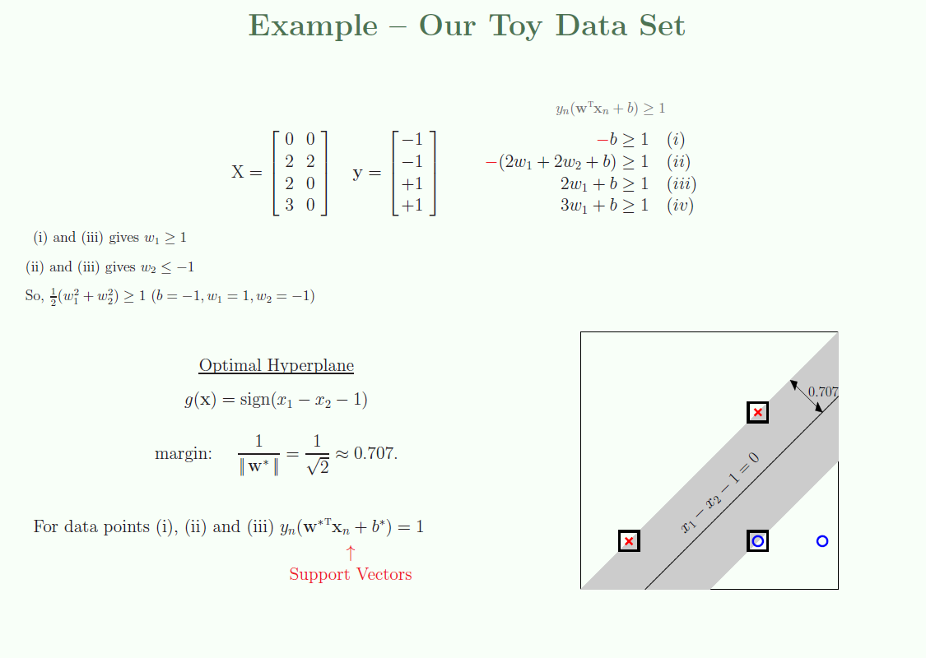
Notes:
For data points which meet their constraints exactly, dist (xn, g). These data points sit on the boundary of the cushion and play an important role. They are support vectors. In a sense, the support vectors are ‘supporting’ the cushion and preventing it from expanding further.

Slide 42
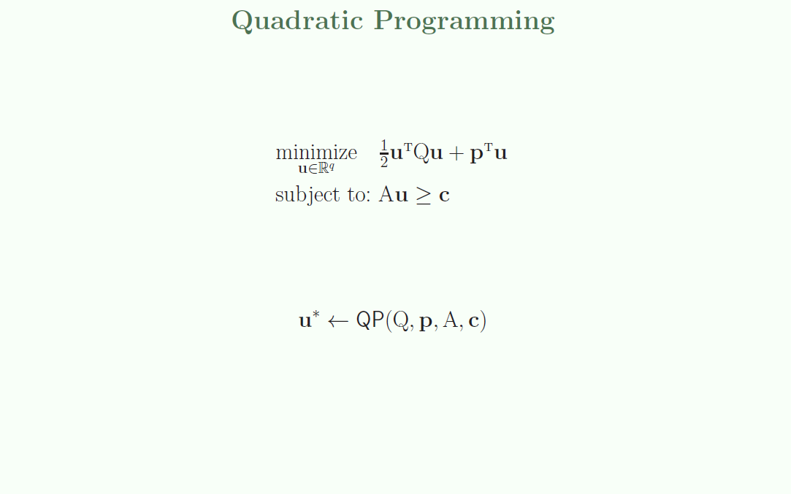
Notes:
For bigger data sets, manually solving the optimization problem in the bottom as we just did is no longer feasible. The good news is that the bottom belongs to a well-studied family of optimization problems known as qp.
Whenever you minimize a convex quadratic function, subject to linear inequality constraints, you can use qp.
QP is such a well studied area that excellent, publicly available solvers exist for many numerical computation platforms. We will not need to know how to solve a QP problem, we will only need to know how to take any given problem and convert it into a standard form which is then input to a QP-solver. We begin by describing the standard form of a QP problem.

Slide 43
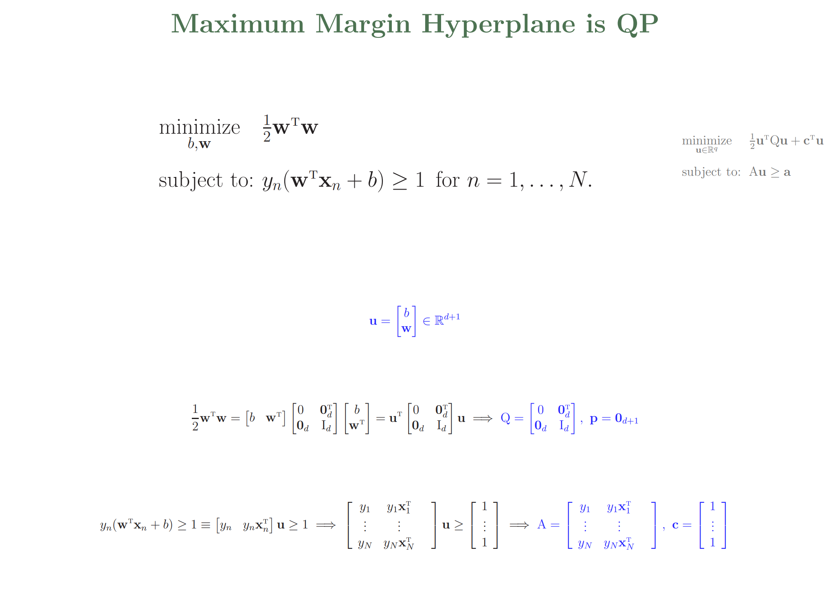

Slide 44
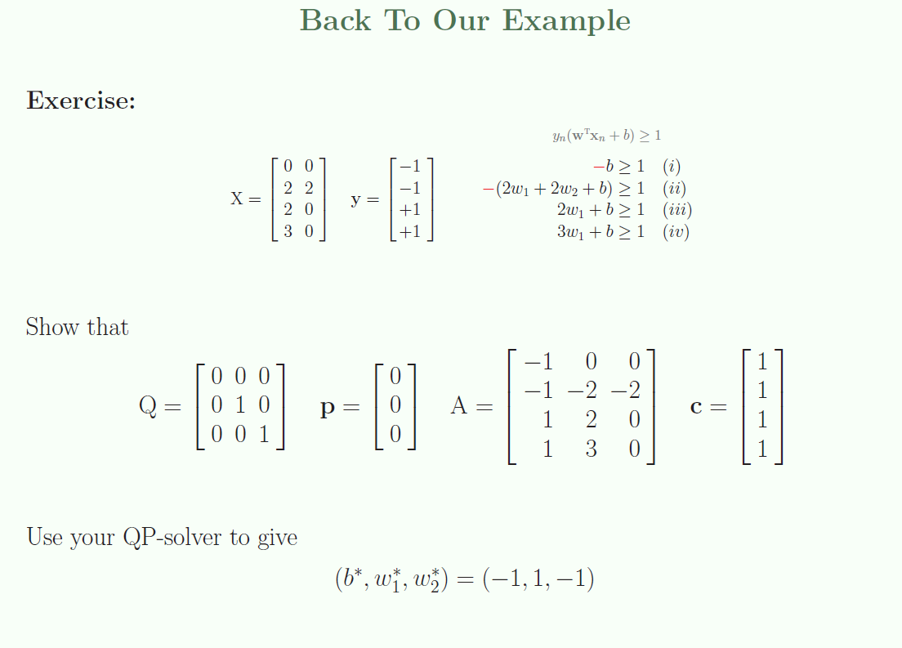

Slide 45
